Slide 1
Integrated Climate Change Adaptation (CCA) and Flood Risk Management Strategy and Plan for the Drin River Basin
Communication plan for the development of the Drin basin flood risk Strategy and Plan
October 12th, 2023
Erdona Demiraj & Ervin Doçaj
Key experts on Stakeholder engagement and consultation

Slide 2
Plan for today…
What and Why?
Communication Plan & floods.drinbasin.org
Shaping consultation process, plan activities and key actors
Discussions: Communication flow, questionary & proposals

Slide 3
What and Why?
Drin Basin and the signing of a related Memorandum of Understanding (Tirana, 25 November 2011)

Slide 4
What and Why?
SAP Goal 3: Develop cooperation and measures to minimise flooding especially in the lower parts of the Drin Basin
Objective: Management of floods risks, and droughts risks by 2030
Component 1 – Hazard and risk knowledge management tools;
Component 2 -Transboundary FRM institutional, legislative and policy framework
Component 3 -Priority community-based climate change adaptation and FRM interventions.
Comprehensive stakeholder engagement and consultation for the development of the FRMS and FRMP

Slide 5
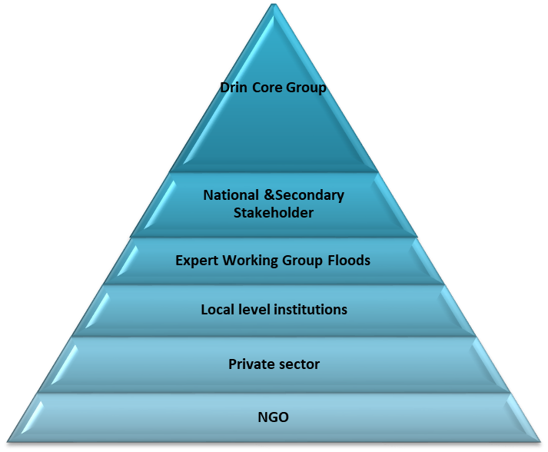
Stakeholders Engagement Approach
Great efforts
Fewer stakeholders
Bottom – Up
Further elaboration
suggested
Solutions
enhance stakeholders’ engagement and
ownership
Top – Down
Information
harmonized,
analyzed, and
presented
Less efforts
More stakeholders

Slide 6
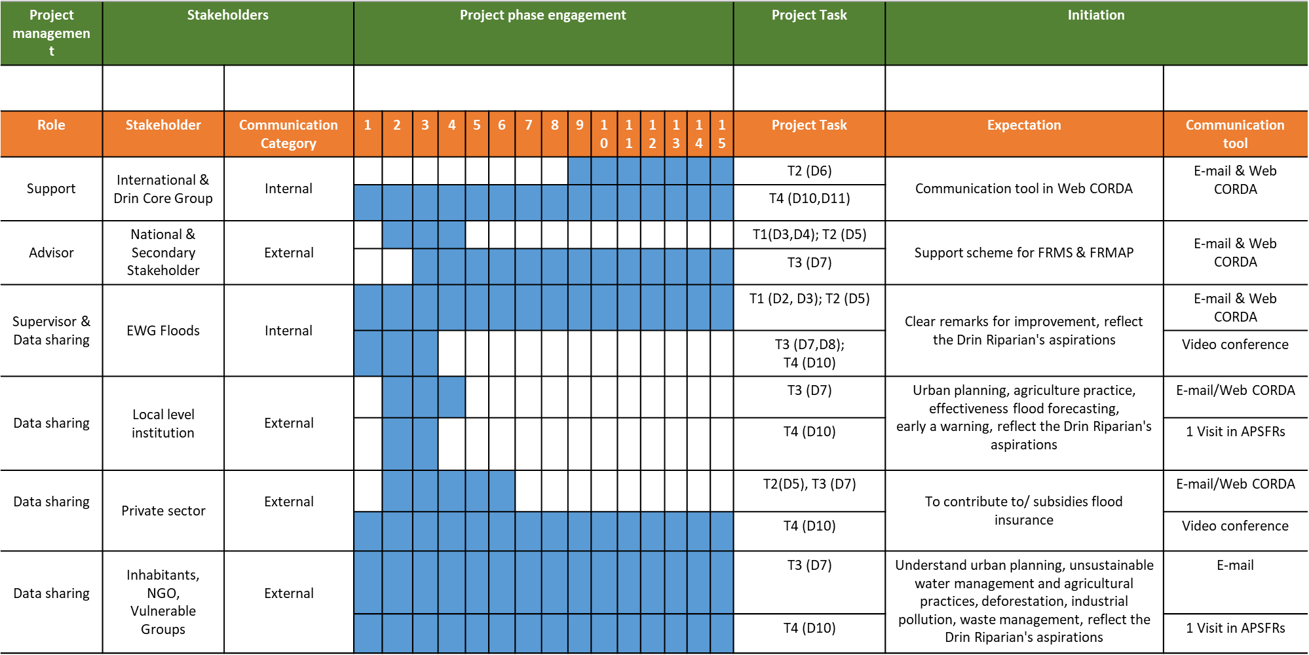
Communication Plan & floods.drinbasin.org

Slide 7
Communication Plan & floods.drinbasin.org

Slide 8
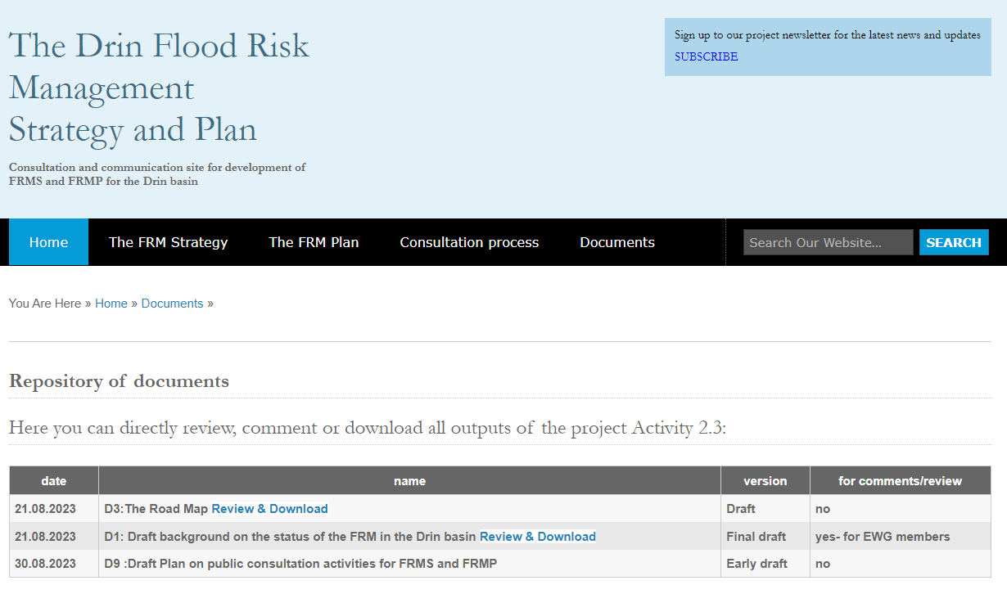
Communication Plan & floods.drinbasin.org

Slide 9
Shaping consultation process, plan activities and key actors
Output
Stakeholder Involved
Top – Down approach
Communication Tool
Time Scheduled
FRMS
Draft FRMS for the Drin basin
Final FRMS for the Drin basin (after consultation and adaptation process)
EWG Floods
International & Drin Core Group, EWG Floods
Website of Drin CORDA, E-Mail
Website of Drin CORDA, E-Mail
12 October 2023
November 2023

Slide 10
Outputs
FRMS
Summary report (5-10 pages) in English, Albanian, Montenegrin & North Macedonian language
Identification of potential information gaps.
How the background information is used for development of the FRMS (methodological approach)?
Are the role of the future FRMS in relation with the national policies described and potential mechanisms of mainstreaming identified?
Do the Strategy present, discuss and meet the goals and vision of the Drin riparian’s?

Slide 11
Shaping consultation process, plan activities and key actors
Output
Stakeholder Involved
Bottom Up approach
Communication Tool
Time Scheduled
FRMP
Draft FRMAP for the Drin Basin
Final FRMAP for the Drin basin (after consultation and adaptation process
National & Secondary Stakeholder, EWG Floods, Local level institution, Private sector, Inhabitants NGO, Vulnerable Groups
EWG Floods
Website of Drin CORDA, E-Mail,
2 Visit in APSFRs
Website of Drin CORDA, E-Mail
May-June 2024
September 2024

Slide 12
Outputs
FRMP
Summary report (5-10 pages) in English, Albanian, Montenegrin & North Macedonian language
Do FRMP identify the definition of the mechanisms of coordination on the basin-wide level?
Do FRMP identify clear assignment of roles and responsibilities and legal and institutional agreements needed?
Do FRMP identify organizational structures, rules and norms changes needed for successful implementation of the FRMP?

Slide 13
Outputs
FRMP
Do FRMP identify technical and socio-environmental requirements for implementation of FRMP
(i.e., social Impact assessment, economic assessment, environmental impact assessment)
Do FRMP identify cumulative financial requirements and socio-economic and environmental effects for implementation of the plan and sources of financing (potential or/and existing)
Do FRMP identify appropriate, information about how the implementation of the measures under the FRMP are aligned and will be coordinated with relevant national policy documents and potential role of the basin wide specific polices (i.e. Land management, etc.)
Do FRMP identify the monitoring, evaluation, and reporting mechanisms?

Slide 14
Open Discussions:
Communication flow, questionary & proposals

Slide 15
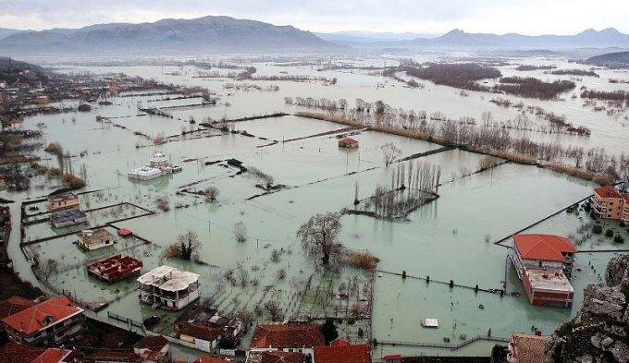
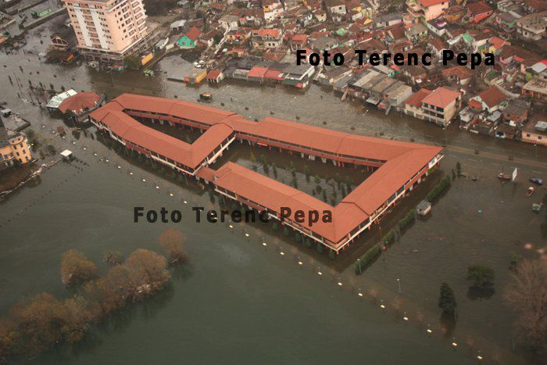
THANKS
Floods in Shkodra/Scutari, January 2021

